Slide 1
ASP.Net Core –Saving data with Entity Framework Core
Kamal Beydoun
Lebanese University – Faculty of Sciences I
Kamal.beydoun@ul.edu.lb

Slide 2
Introduction
EF (Entity Framework) Core is a library that lets you quickly and easily build database access code for your ASP.NET Core applications.
It’s modeled on the popular Entity Framework 6.x library
It has significant changes
It is more than an upgrade.
I’m going to be using SQL Server Express’ LocalDB feature.
installed as part of Visual Studio 2017
Notes:
For an in-depth look at EF Core I recommend, Entity Framework Core in Action by Jon P Smith (Manning, 2018). Alternatively, you can read about EF Core and its cousin, Entity Framework, on the Microsoft documentation website at https://docs.microsoft.com/en-
us/ef/core/index.
-----------------
For this chapter, and the rest of the book, I’m going to be using SQL Server Express’ LocalDB feature. This is installed as part of Visual Studio 2017 (when you choose the .NET Desktop Development workload) and provides a lightweight SQL Server engine. Very little of the code is specific to SQL Server, so you should be able to follow along with a different database if you prefer.

Slide 3
What is EF Core?
EF Core is a library that provides an object-oriented way to access databases.
It acts as an object-relational mapper (ORM), communicating with the database for you and mapping database responses to .NET classes and objects.
The most commonly used family is relational databases, accessed using Structured Query Language (SQL).
EF Core can map Microsoft SQL Server, MySQL, Postgres, and many other relational databases.
EF Core was designed to work with nonrelational, NoSQL, or document databases too but, at the time of writing, that feature hasn’t yet been implemented.
Notes:
With an object-relational mapper (ORM), you can manipulate a database using object-oriented concepts such as classes and objects by mapping them to database concepts such as tables and columns.
EF Core uses a provider model, so that support for other relational databases can be plugged in later, as they become available.

Slide 4
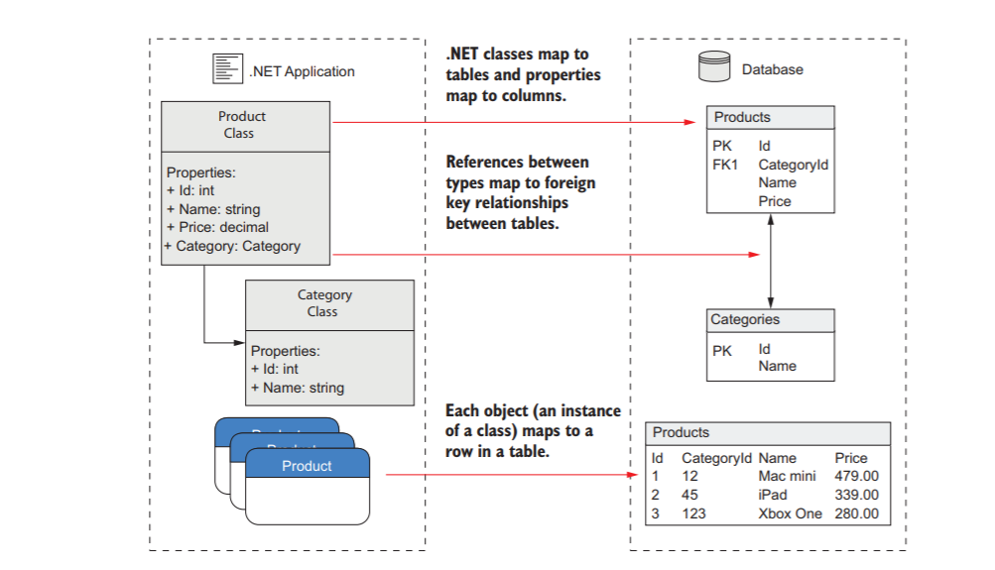
What is EF Core?
Notes:
https://csharp.christiannagel.com/2018/09/05/efcorecosmos/

Slide 5
Why use an object-relational mapper (ORM)?
The speed with which you can develop an application.
You can stay in the familiar territory of object-oriented .NET, in many cases without ever needing to directly manipulate a database or write custom SQL.
It handles the connection to the database, generating the SQL, and mapping data back to your POCO objects.
ORMs like EF Core keep track of which properties have changed on any objects they rehydrate from the database.
This lets you load an object from the database by mapping it from a database table, modify it in .NET code, and then ask the ORM to update the associated record in the database.
Notes:
POCO: Plain Old CLR Object
In software engineering, a plain old CLR object (POCO) is a simple object created in the Common Language Runtime (CLR) of the .NET Framework which is unencumbered by inheritance or attributes.

Slide 6
Drawbacks of ORM
They hide you from the database.
ORMs are abstractions over a number of concepts,
Use an ORM for the quick development of the bulk of your application
Notes:
The next section compares EF Core to Microsoft’s other offering, Entity Framework, but there many other alternatives you could consider, such as Dapper and NHibernate, each with their own set of trade-offs.

Slide 7
When should you choose EF Core?
Cross platform —EF Core targets .NET Standard, so it can be used in cross platform apps that target .NET Core
Database providers —Both EF 6.x and EF Core let you connect to various database types by using pluggable providers.
Performance —The performance of EF 6.x has been a bit of a black mark on its record, so EF Core aims to rectify that.
Features —EF Core has some features that EF 6.x doesn’t have (batching statements, client-side key generation, in-memory database for testing), but EF 6.x is much more feature-rich than EF Core.
Notes:
Microsoft designed EF Core as a reimagining of the mature Entity Framework 6.x (EF 6.x) ORM, which it released in 2008. With ten years of development behind it, EF 6.x is a stable and feature-rich ORM, though it runs on the full .NET Framework, not .NET Core.
EF Core has a growing number of providers, but there aren’t as many for EF 6.x.
EF Core unlikely to ever reach the performance of a more lightweight ORM, such as Dapper, or handcrafted SQL statements.
Very Interesting :
https://docs.microsoft.com/ar-sa/ef/efcore-and-ef6/index

Slide 8
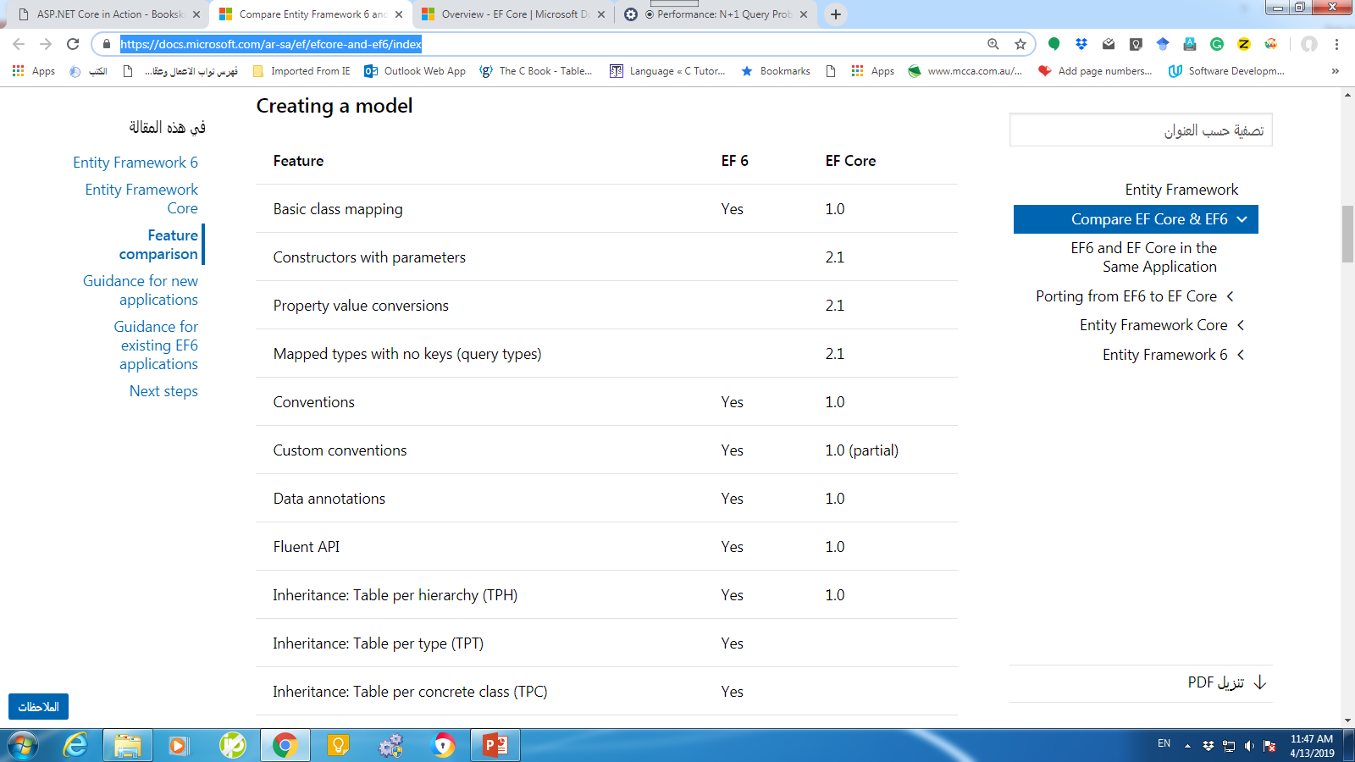
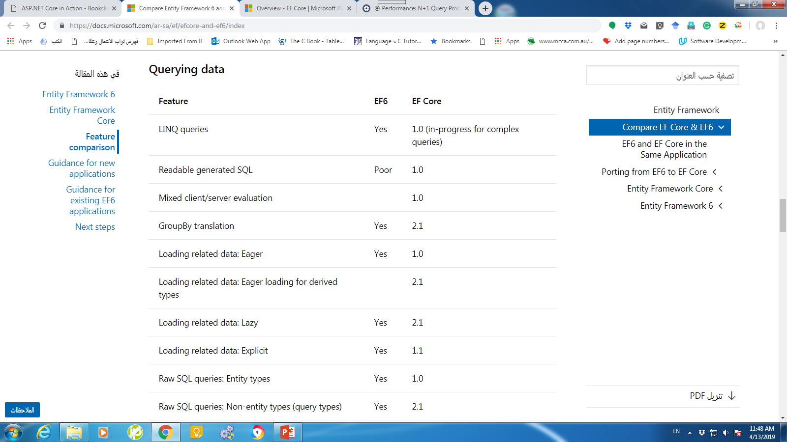
When should you choose EF Core?
If you’re working on a new ASP.NET Core application, you want to use an ORM for rapid development, and you don’t require any of the unavailable features, then EF Core is a great contender.
https://docs.microsoft.com/ar-sa/ef/efcore-and-ef6/index
Notes:
It’s also supported out of the box by various other subsystems of ASP.NET Core. For instance, in chapter 14 you’ll see how to use EF Core with the ASP.NET Core Identity authentication system for managing users in your apps.

Slide 9
Mapping a database to your application code
An entity is a .NET class that’s mapped by EF Core to the database.
When you interact with EF Core, you’ll be primarily using POCO entities and a database context that inherits from the DbContext EF Core class.
You can potentially have multiple DbContexts in your application and can even configure them to integrate with different databases.

Slide 10
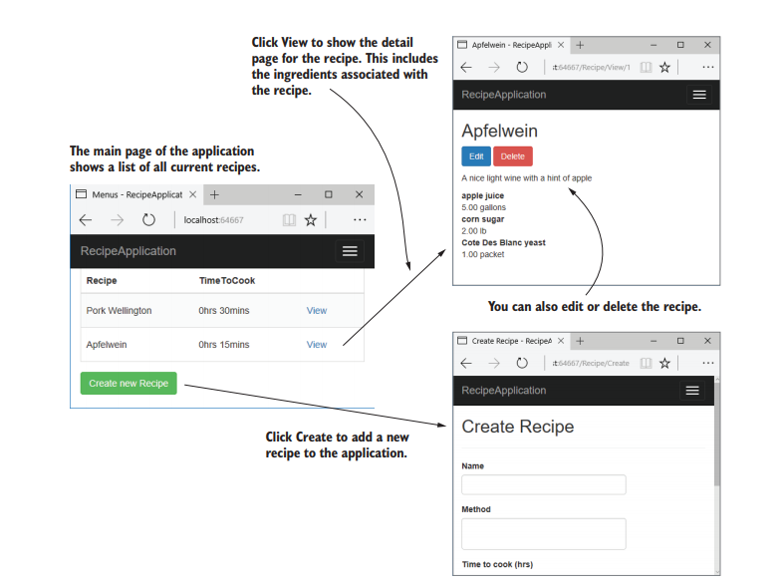
App to be implemented
you need with its two entities, Recipe and Ingredient.

Slide 11
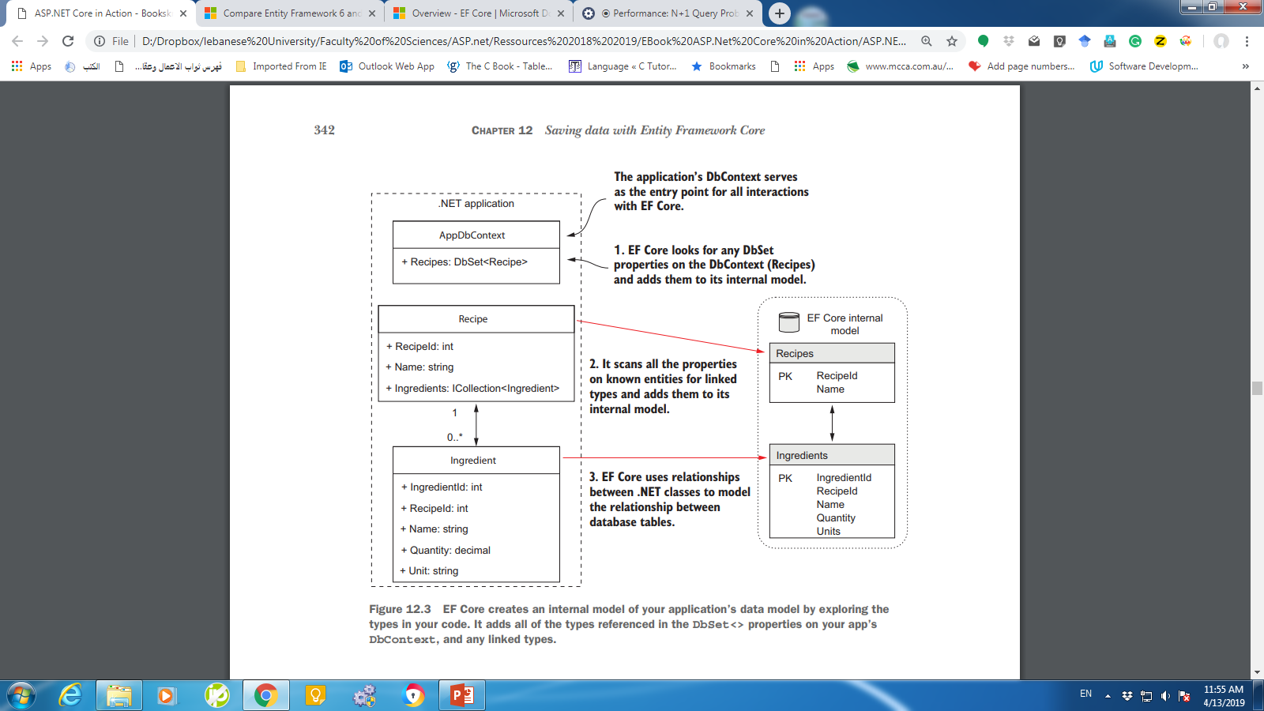
When your application first uses EF Core, it creates an internal representation of the database, based on the DbSet<T> properties on your application’s DbContext and the entity classes themselves.
Notes:
Each entity is mapped to a table in the database, but EF Core also maps the relationships between the entities.
Each recipe can have many ingredients, but each ingredient (which has a name, quantity, and unit) belongs to one recipe, so this is a many-to-one relationship.

Slide 12
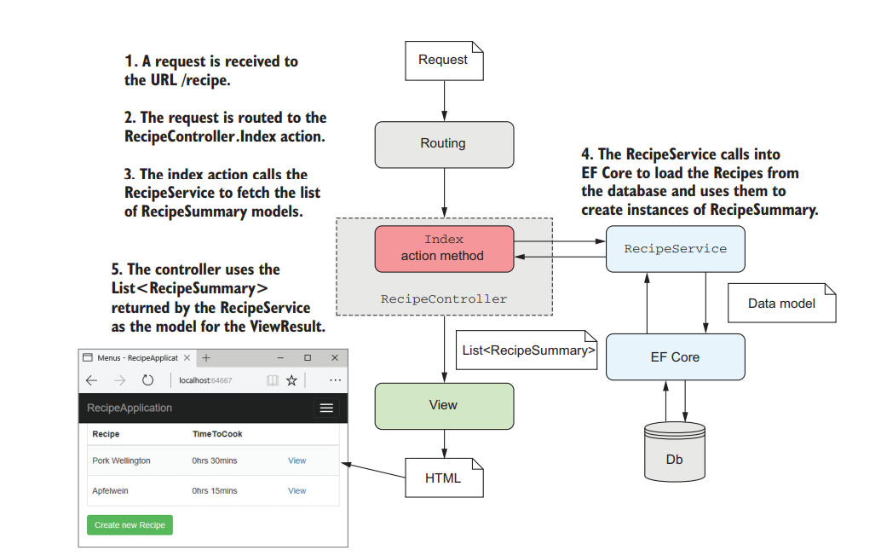
Adding EF Core to an application
Interaction with EF Core occurs in a service layer that encapsulates all of the data access outside of the MVC framework.

Slide 13
Adding EF Core to an application
Choose a database provider; for example, MySQL, Postgres, or MS SQL Server.
Install the EF Core NuGet packages.
Design your app’s DbContext and entities that make up your data model.
Register your app’s DbContext with the ASP.NET Core DI container.
Use EF Core to generate a migration describing your data model.
Apply the migration to the database to update the database’s schema.

Slide 14
Choosing a database provider and installing EF Core
Adding support for a particular database involves adding the correct NuGet package to your csproj file. For example:
PostgreSQL—Npgsql.EntityFrameworkCore.PostgreSQL
Microsoft SQL Server—Microsoft.EntityFrameworkCore.SqlServer
MySQL—MySql.Data.EntityFrameworkCore
SQLite—Microsoft.EntityFrameworkCore.SQLite
dotnet restore from the command line (or let Visual Studio automatically restore for you).
Notes:
list of providers here at https://docs.microsoft.com/en-us/ ef/core/providers/
You install a database provider into your application in the same way as any other library: by adding a NuGet package to your project’s csproj file and running dotnet restore from the command line (or letting Visual Studio automatically restore for you).

Slide 15
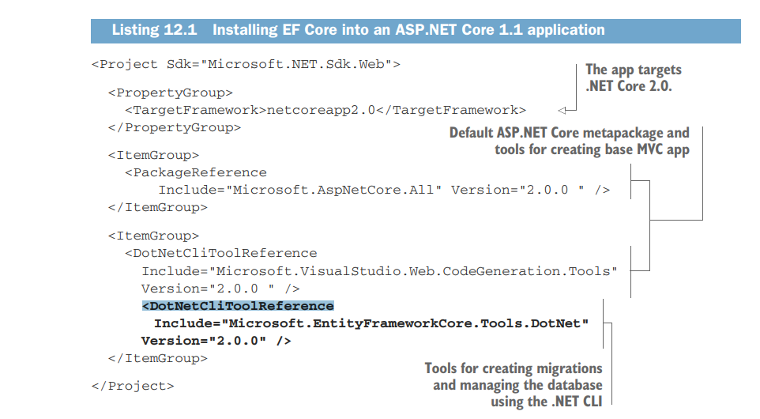
csproj file
ASP.NET Core 2.0 includes the EF Core libraries as part of the framework provided Microsoft.AspNetCore.All package.
Notes:
the only package I need to add is the tooling package. Remember, you add NuGet packages as PackageReference elements, and tool packages as DotNetCliToolReference elements.

Slide 16
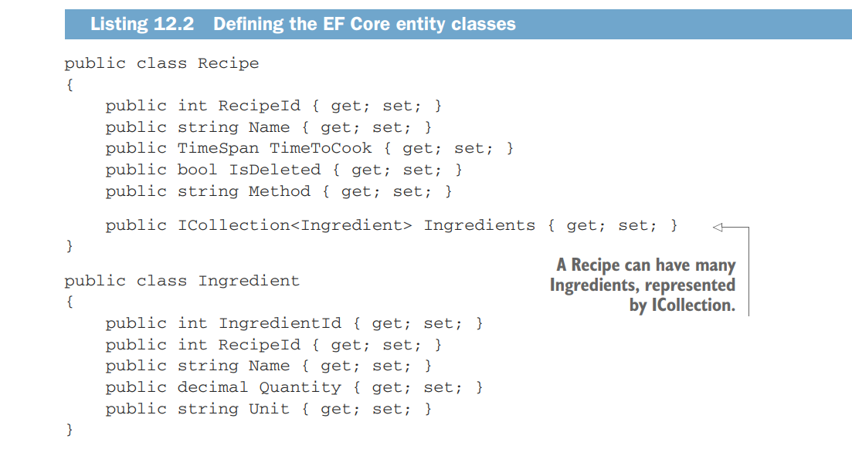
Building a data model
Notes:
EF Core heavily favors a convention over configuration approach, as you can see in this listing, which shows the Recipe and Ingredient entity classes for your app.
Conventions :
For example, the Recipe class has a RecipeId property and the Ingredient class has an IngredientId property. EF Core identifies this pattern of TId as indicating the primary key of the table.
Another convention visible here is the RecipeId property on the Ingredient class. EF Core interprets this to be a foreign key pointing to the Recipe class.
When considered with ICollection on the Recipe class, this represents a many-to-one relationship.
You can also use DataAnnotations attributes to decorate your entity classes, controlling things like column naming or string length. EF Core will use these attributes to override the default conventions.

Slide 17
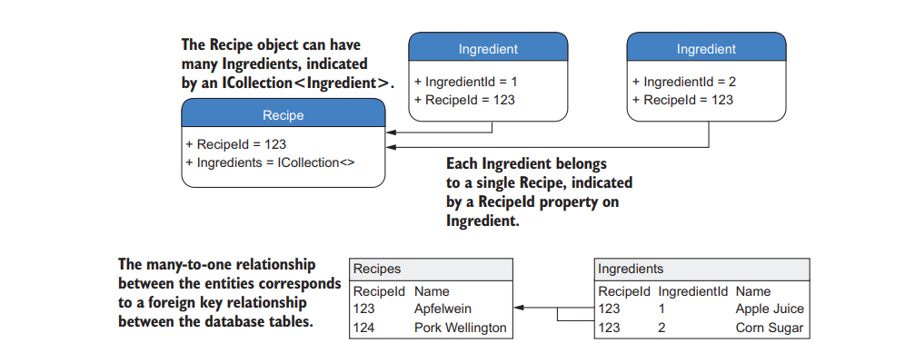
Building a data model

Slide 18
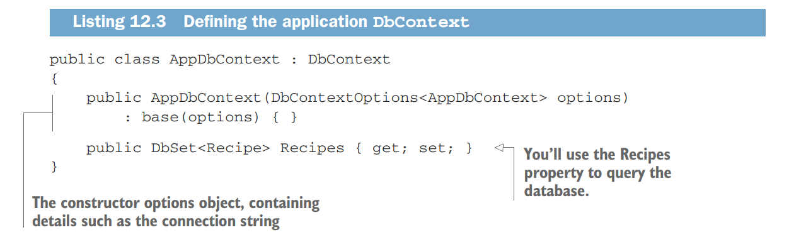
Building a data model
Three classes: AppDbContext, Recipe, and Ingredient (will be modeled by EF Core as it’s exposed on the Recipe. ).
The two entities will be mapped to tables and their columns to properties, and you’ll use the AppDbContext to access them.
Notes:
The AppDbContext for your app is simple, containing a list of your root entities, but you can do a lot more with it in a more complex application.
If you wanted, you could completely customize how EF Core maps entities to the database, but for this app you’re going to use the defaults.
You didn’t list Ingredient on AppDbContext, but it will be modeled by EF Core as it’s exposed on the Recipe. You can still access the Ingredient objects in the database, but you have to go via the Recipe entity’s Ingredients property to do so.
This code first approach is typical, but if you have an existing database, you can automatically generate the EF entities and DbContext instead. (More information can be found at http://mng.bz/Ymtw.)

Slide 19
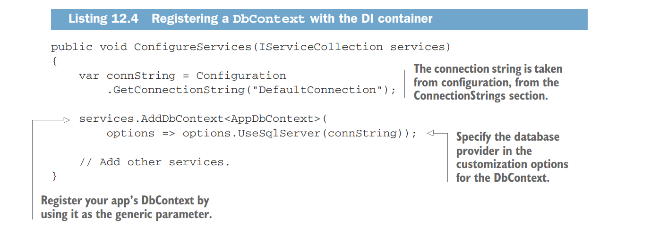
Registering a data context
If you’re using a different database provider, for example a provider for PostgreSQL, you will need to call the appropriate Use* method on the options object when registering your AppDbContext.
Notes:
The configuration for your app is, again, nice and simple, as you can see in the following listing. You set the database provider with the UseSqlServer extension
method, made available by the Microsoft.EntityFrameworkCore.SqlServer package, and pass it a connection string.
The connection string is a typical secret as I discussed in the previous chapter, so loading it from configuration makes sense.

Slide 20
Managing changes with migrations
EF Core provides its own version of schema management called migrations.
Migrations provide a way to manage changes to a database schema when your EF Core data model changes.
A migration is a C# code file in your application that defines how the data model changed—which columns were added, new entities, and so on.
Migrations provide a record over time of how your database schema evolved as part of your application, so the schema is always in sync with your app’s data model.
Notes:
Applying migrations modifies the database, so you always have to be aware of data loss. If you remove a table from the database using a migration and then rollback the migration, the table will be recreated, but the data it previously contained will be gone forever!

Slide 21
Creating your first migration
Before you can create migrations, you’ll need to install the necessary tooling.
Package manager console—Provides a number of PowerShell cmdlets for use inside Visual Studio’s Package Manager Console (PMC).
You can install them directly from the PMC or by adding the Microsoft.EntityFrameworkCore.Tools package to your project. They’re also included as part of the Microsoft.AspNetCore.All metapackage.
.NET CLI—Cross-platform tooling that you can run from the command line.
You can install these by adding the Microsoft.EntityFrameworkCore.Tools.DotNet package to your project.

Slide 22
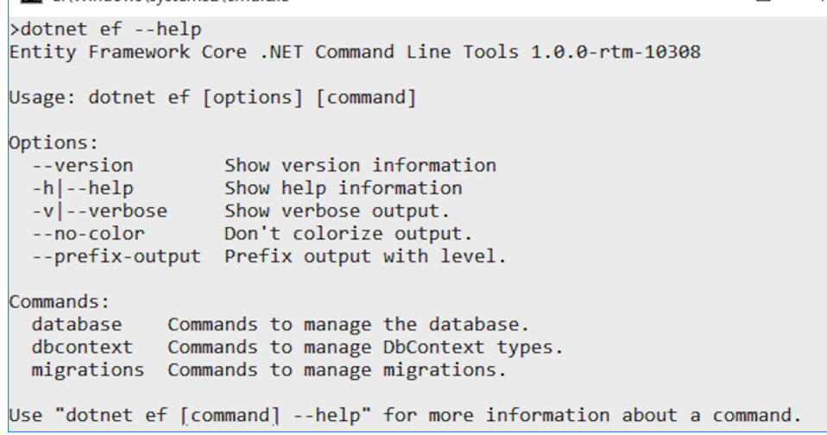
Creating your first migration
Make sure you have restored packages and check the folder you’re executing from.
run dotnet ef tools from the project folder in which you have registered your AppDbContext, not at the solution-folder level.

Slide 23
Creating your first migration
dotnet ef migrations add InitialSchema
This command creates three files in your solution:
Migration file—A file with the Timestamp_MigrationName.cs format. This describes the actions to take on the database, such as Create table or Add column.
Migration designer.cs file—This describes EF Core’s internal model of your data model at the point in time the migration was generated.
AppDbContextModelSnapshot.cs—This describes EF Core’s current internal model. This will be updated when you add another migration, so it should always be the same as the current, latest migration.
Notes:
These three files encapsulate the migration process but adding a migration doesn’t update anything in the database itself. For that, you must run a different command to apply the migration to the database.

Slide 24
Creating your first migration
You can apply migrations in one of three ways:
Using the .NET CLI
Using the Visual Studio PowerShell cmdlets
In code, by obtaining an instance of your AppDbContext and calling context.Database.Migrate().
Which is best for you is a matter of how you’ve designed your application, how you’ll update your production database, and your personal preference.

Slide 25
Apply migrations to a database
dotnet ef database update
(from the project folder of your application)
Builds your application.
Loads the services configured in your app’s Startup class, including AppDbContext.
Checks whether the database in the AppDbContext connection string exists. If not, creates it.
Updates the database by applying any unapplied migrations.

Slide 26
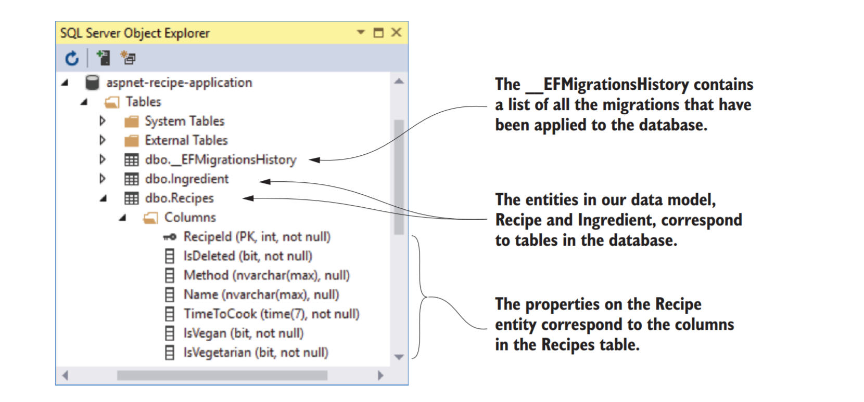
Next time you run dotnet ef database update, EF Core can compare this table to the list of migrations in your app and will apply only the new ones to your database.
Notes:
When you apply the migrations to the database, EF Core creates the necessary tables in the database and adds the appropriate columns and keys.
You may have also noticed the __EFMigrationsHistory table. EF Core uses this to store the names of migrations that it’s applied to the database.
Next time you run dotnet ef database update, EF Core can compare this table to the list of migrations in your app and will apply only the new ones to your database.

Slide 27
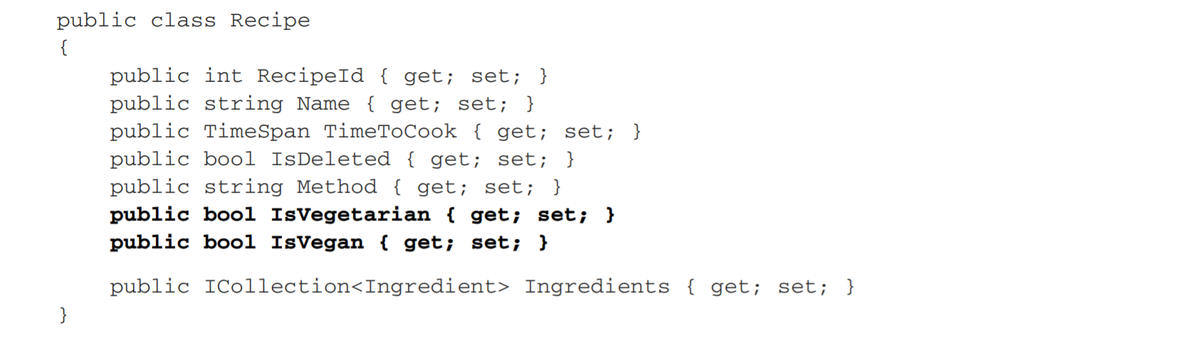
Adding a second migration
Notes:
Most applications inevitably evolve, whether due to increased scope or simple maintenance. Adding properties to your entities, adding new entities entirely, and removing obsolete classes—all are likely

Slide 28
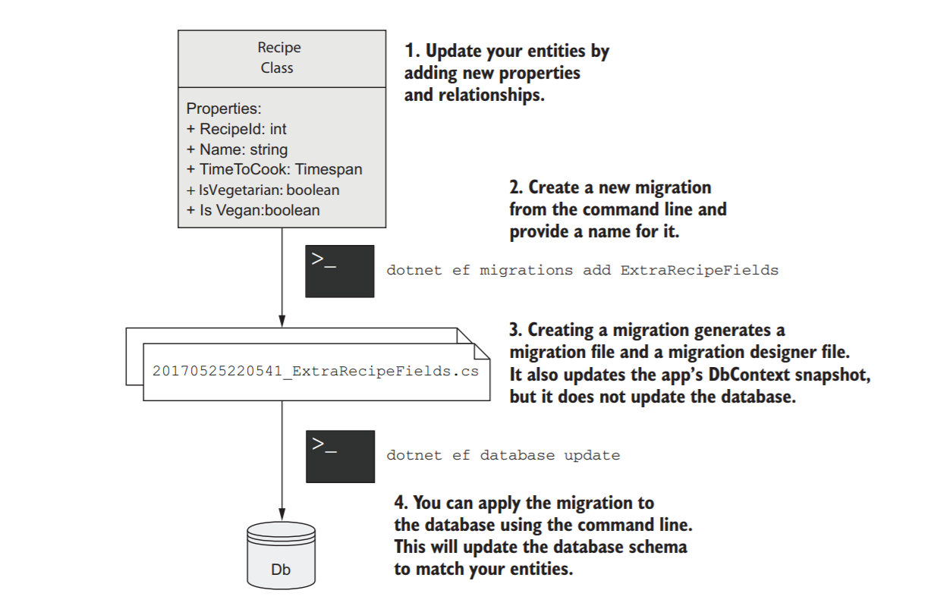
Adding a second migration

Slide 29
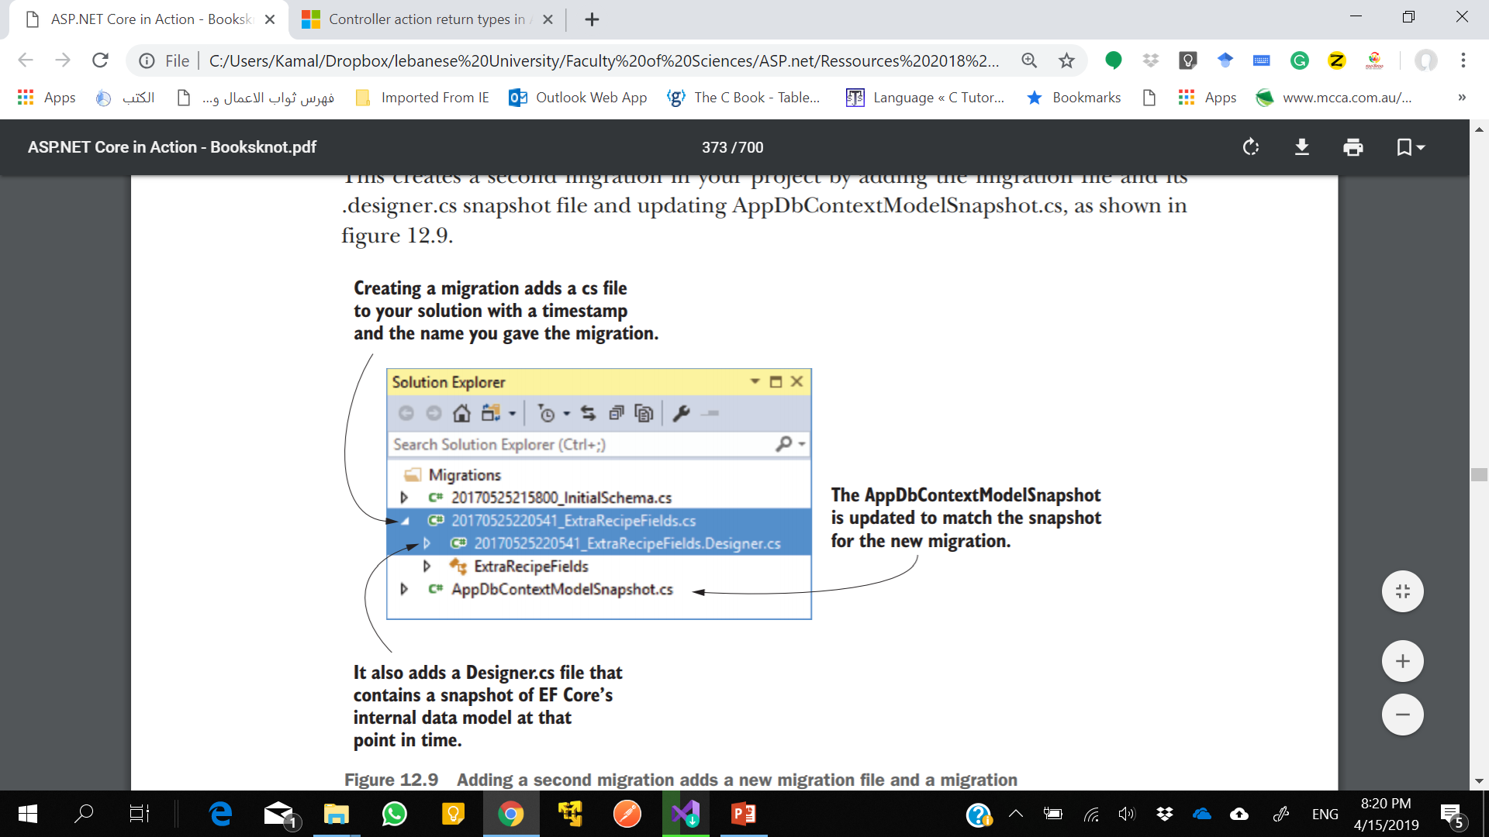
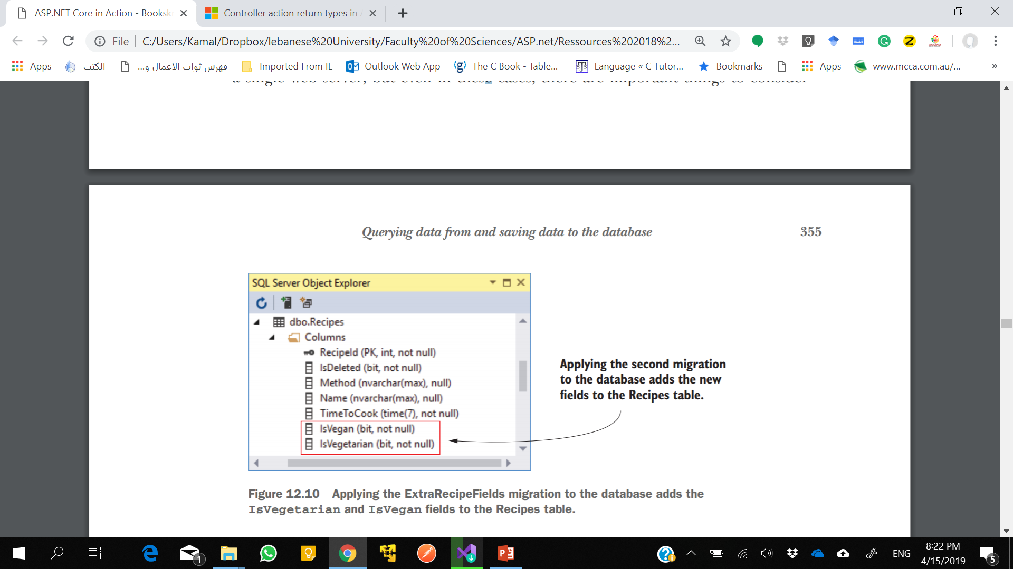
Adding a second migration
Notes:
Migrations are easy to use when you’re working alone, or when you’re deploying to a single web server, but even in these cases, there are important things to consider when deciding how to manage your databases. For apps with multiple web servers using a shared database, or for containerized applications, you have even more things to think about.

Slide 30
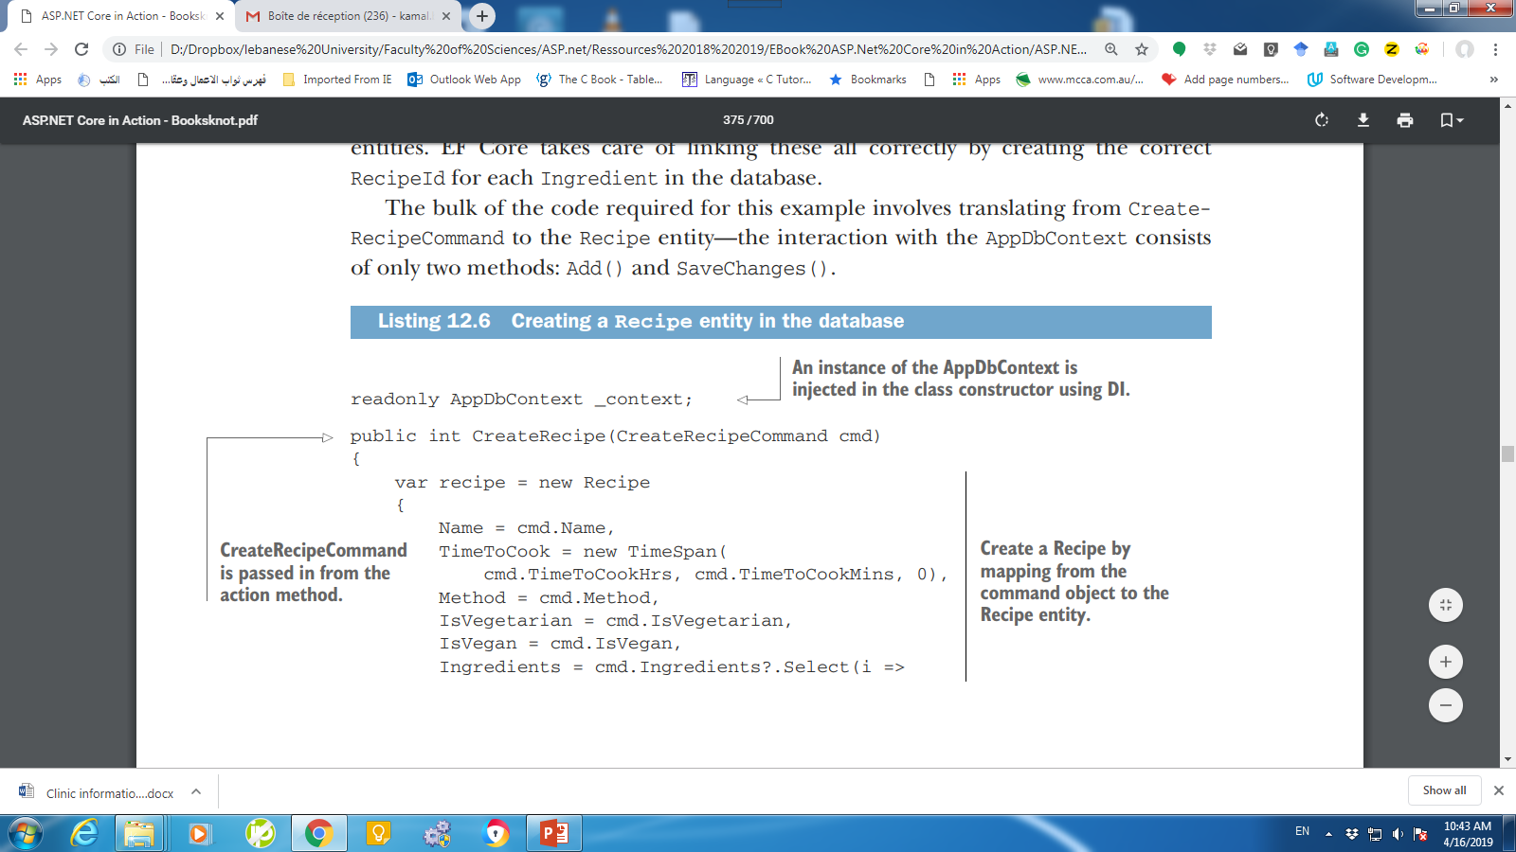
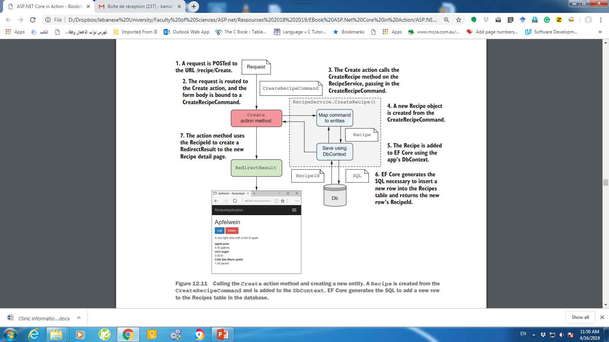
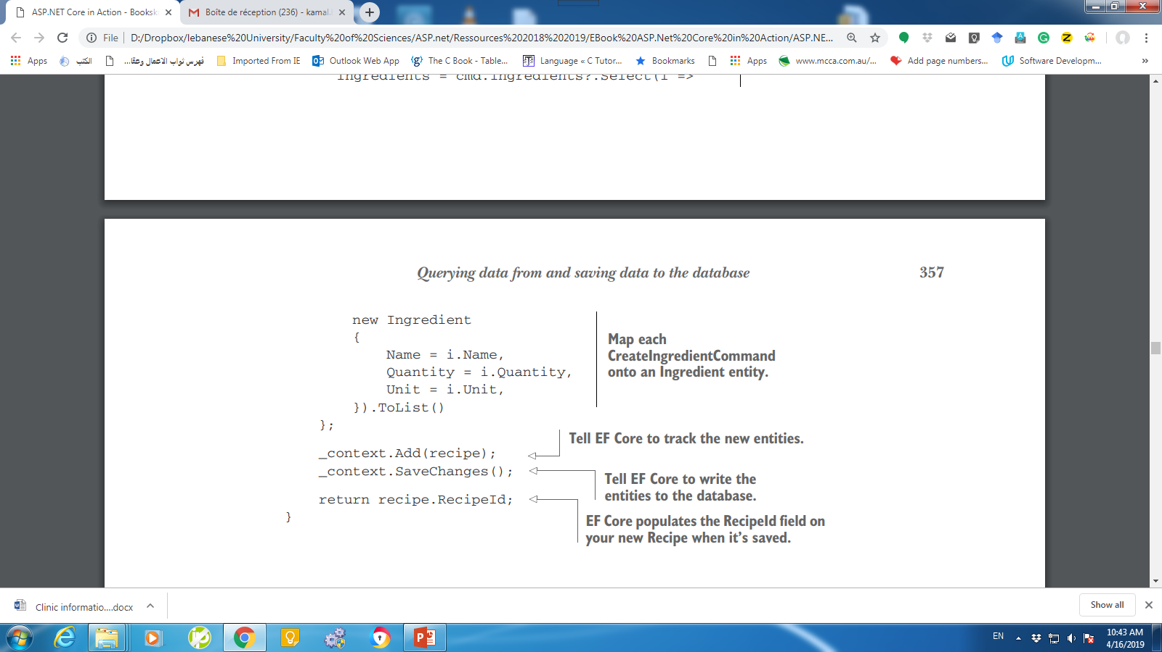
Saving data to the database : Creating a record
Notes:
The business logic for creating a recipe in this application is simple—there is no logic! Map the command binding model provided by the controller to a Recipe entity and its Ingredients, add the Recipe object to AppDbContext, and save that in the database.
Many simple, equivalent, sample applications using EF or EF Core allow you to bind directly to the Recipe entity as the view model for your MVC actions. Unfortunately, this exposes a security vulnerability known as overposting and is a bad practice. If you want to avoid the boilerplate mapping code in your applications, consider using a library such as AutoMapper (http://automapper.org/).
If there’s a problem when EF Core tries to interact with your database—you haven’t run the migrations to update the database schema, for example—it will throw an exception.

Slide 31
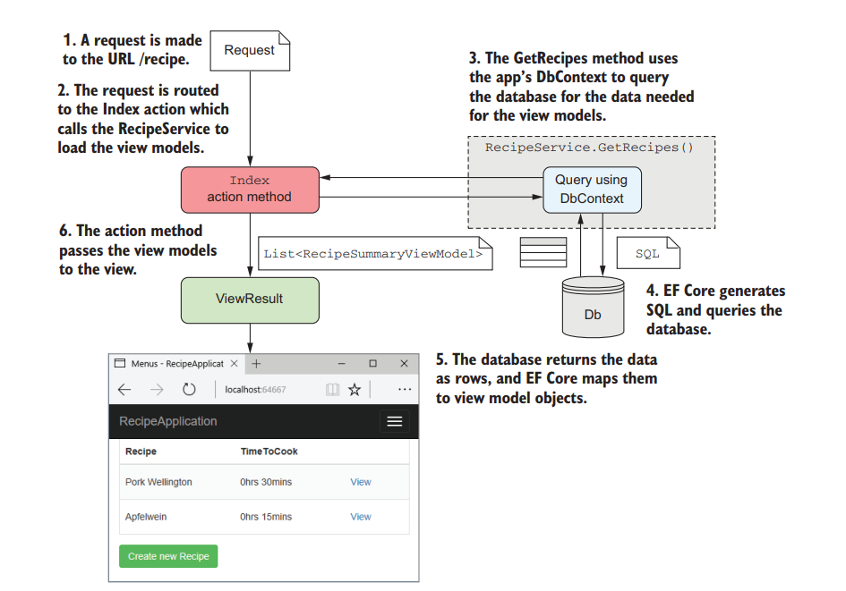
Loading a list of records
Notes:
Creating a view model is technically a UI concern rather than a business logic concern. I’m returning them directly from RecipeService here mostly to hammer home that you shouldn’t be using EF Core entities directly in your action methods.

Slide 32
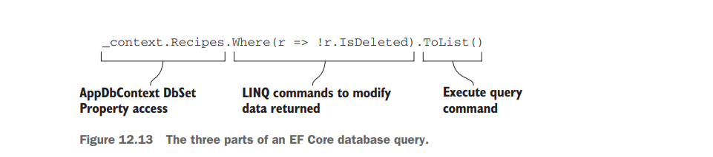
Loading a list of records
The DbSet property on AppDataContext is an IQueryable, so you can use all the usual Select() and Where() clauses that you would with other IQueryable providers
EF Core will convert these into a SQL statement to query the database with when you call an execute function such as ToList(), ToArray(), or Single().
Notes:
The GetRecipes method in RecipeService is conceptually simple and follows a common pattern for querying an EF Core database, as shown in figure 12.13.
EF Core uses a fluent chain of LINQ commands to define the query to return on the database.
The DbSet property on AppDataContext is an IQueryable, so you can use all the usual Select() and Where() clauses that you would with other IQueryable providers.
EF Core will convert these into a SQL statement to query the database with when you call an execute function such as ToList(), ToArray(), or Single().
You can also use the Select() extension method to map to objects other than your entities as part of the SQL query. You can use this to efficiently query the database by only fetching the columns you need.

Slide 33
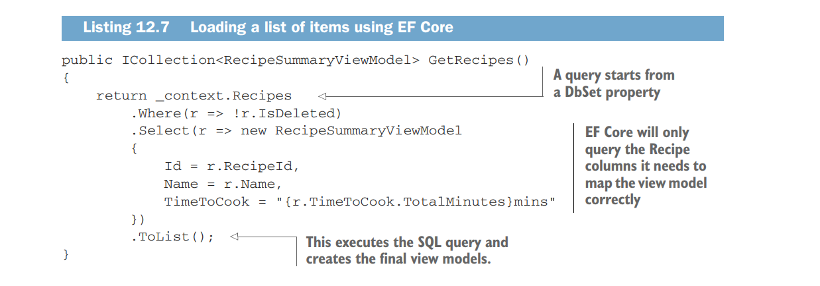
Loading a list of records
Notes:
Listing 12.7 shows the code to fetch a list of RecipeSummaryViewModels, following the same basic pattern as in figure 12.12.
It uses a Where LINQ expression to filter out recipes marked as deleted, and a Select clause to map to the view models.
The ToList() command instructs EF Core to generate the SQL query, execute it on the database, and build RecipeSummaryViewModel from the data returned.
Notice that in the Select method, you convert the TimeToCook property from a TimeSpan to a string using string interpolation: TimeToCook = "{x.TimeToCook.TotalMinutes}mins“
I said before that EF Core converts the series of LINQ expressions into SQL, but that’s only a half-truth; EF Core can’t or doesn’t know how to convert some expressions to SQL. For those cases, such as in this example, EF Core finds the fields from the DB that it needs in order to run the expression on the client side, selects those from the database, and then runs the expression in C# afterwards. This lets you combine the power and performance of database-side evaluation without compromising the functionality of C#.

Slide 34
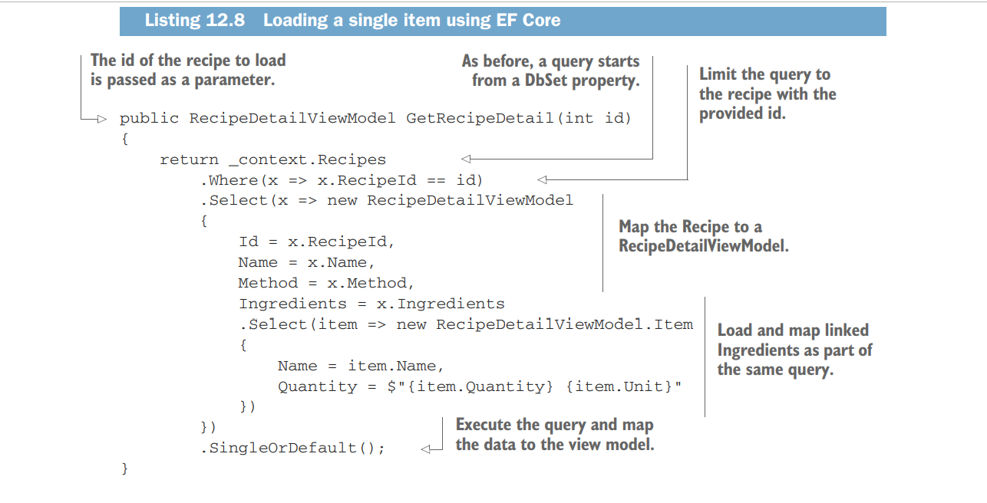
Loading a single record
Notes:
Notice that, as well as mapping the Recipe to a RecipeDetailViewModel, you also map the related Ingredients for a Recipe, as though you’re working with the objects
directly in memory. This is one of the advantages of using an ORM—you can easily map child objects and let EF Core decide how best to build the underlying queries to
fetch the data.
EF Core logs all the SQL statements it runs as LogLevel.Information events by default, so you can easily see what queries are being run against the database.

Slide 35
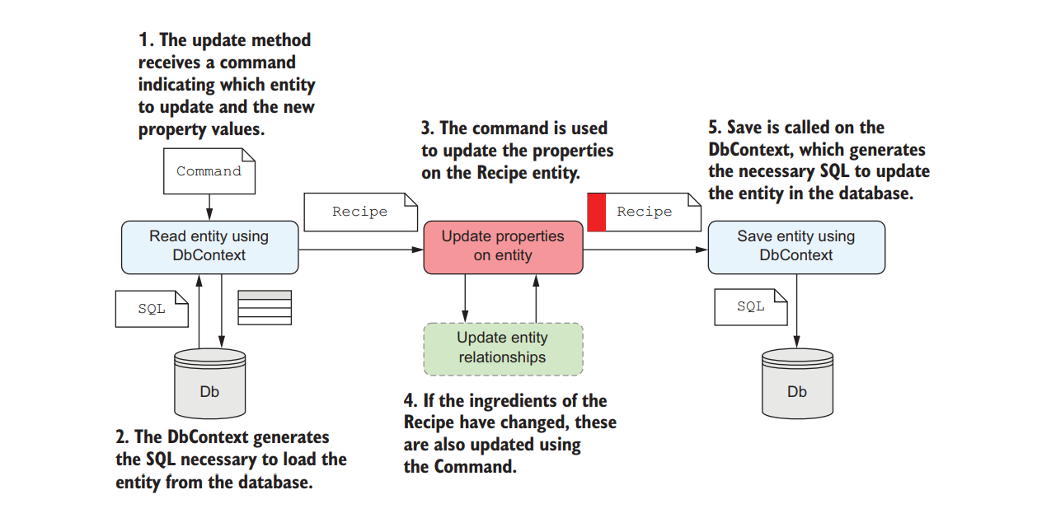
Updating a model with changes

Slide 36
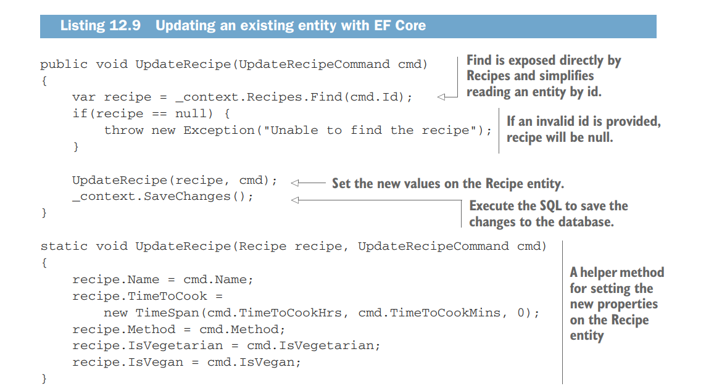
Updating a model with changes
Notes:
In this example, I read the Recipe entity using the Find(id) method exposed by DbSet. This is a simple helper method for loading an entity by its ID, in this case RecipeId. I could’ve written an equivalent query directly using LINQ as _context.Recipes.Where(r=>r.RecipeId == cmd.Id).FirstOrDefault();
Using Find() is a little more declarative and concise. You may be wondering how EF Core knows which columns to update when you call SaveChanges(). The simplest approach would be to update every column—if the field hasn’t changed, then it doesn’t matter if you write the same value again. But EF Core is a bit more clever than that.
EF Core internally tracks the state of any entities it loads from the database. It creates a snapshot of all the entity’s property values, so it can track which ones have changed. When you call SaveChanges(), EF Core compares the state of any tracked entities (in this case, the Repair entity) with the tracking snapshot. Any properties that have been changed are included in the UPDATE statement sent to the database, unchanged properties are ignored.

Slide 37
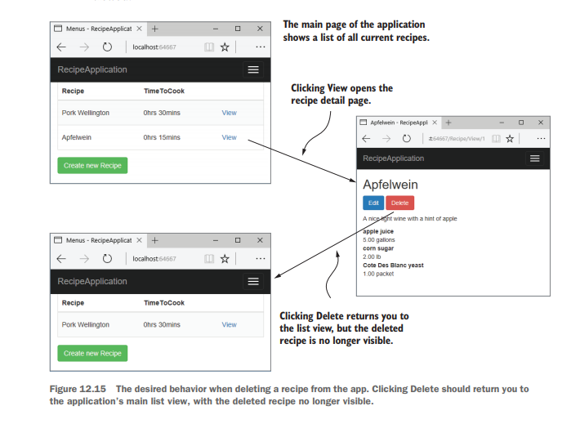
Delete a record

Slide 38
Delete Record
EF Core can easily handle these true deletion scenarios for you with the DbContext .Remove(entity) command.
What you mean when you find a need to delete data is to archive it or hide it from the UI.
A common approach to handling this scenario is to include some sort of “Is this entity deleted” flag on your entity, such as the IsDeleted flag I included on the Recipe entity:
public bool IsDeleted {get;set;}

Slide 39
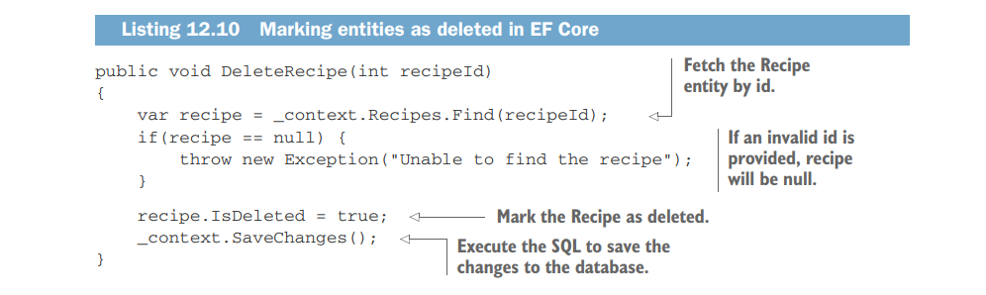
Delete Record
Notes:
With this approach, you can create a delete method on RecipeService, which updates the IsDeleted flag, as shown in the following listing. In addition, you should ensure you have Where() clauses in all the other methods in your RecipeService, to ensure you can’t display a deleted Recipe, as you saw in listing 12.9, for the GetRecipes() method.
EF Core 2.0 gained a feature called Model-level query filters. These allow you to specify a Where clause at the model level, so you could, for example, ensure that EF Core never loads Recipes for which IsDeleted is true. See this announcement post for details: https://github.com/aspnet/ EntityFrameworkCore/ issues/8923.

Slide 40
Using EF Core in production applications
Scaffolding of columns—EF Core uses conservative values for things like string columns by allowing strings of unlimited length.
In practice, you’ll often want to restrict these and other data types to sensible values.
Validation—You can decorate your entities with DataAnnotations validation attributes, but EF Core won’t automatically validate the values before saving to the database. This differs from EF 6.x behavior, in which validation was automatic.
Notes:
The following topics aren’t essential to getting started with EF Core, but you’ll quickly come up against them if you build a production-ready app.

Slide 41
Using EF Core in production applications
Handling concurrency—EF Core provides a number of ways to handle concurrency, where multiple users attempt to update an entity at the same time. One partial solution is through the use of Timestamp columns on your entities.
Synchronous vs. asynchronous—EF Core provides both synchronous and asynchronous commands for interacting with the database.
Often, async is better for web apps, but there are nuances to this argument that make it impossible to recommend one approach over the other in all situations.

Slide 42
Using EF Core in production applications
Automatic migrations—If you automatically deploy your app to production as part of some sort of DevOps pipeline, you’ll inevitably need some way of applying migrations to a database automatically. You can tackle this in a number of ways, such as scripting the .NET CLI, applying migrations in your app’s startup code, or using a custom tool. Each approach has its pros and cons.
Multiple web hosts—One specific consideration is whether you have multiple web servers hosting your app, all pointing to the same database. If so, then applying migrations in your app’s startup code becomes harder, as you must ensure only one app can migrate the database at a time.

Slide 43
Using EF Core in production applications
Making backward-compatible schema changes—A corollary of the multiple-web host approach is that you’ll often be in a situation where your app is accessing a database that has a newer schema than the app thinks. That means you should normally endeavor to make schema changes backward-compatible wherever possible.
Storing migrations in a different assembly—In this chapter, I included all my logic in a single project, but in larger apps, data access is often in a different project to the web app. For apps with this structure, you must use slightly different commands when using the .NET CLI or PowerShell cmdlets.
Seeding data—When you first create a database, you often want it to have some initial seed data, such as a default user. EF 6.X had a mechanism for seeding data built in, whereas EF Core requires you to explicitly seed your database yourself.

Slide 44
Summary
EF Core is an object-relational mapper (ORM) that lets you interact with a database by manipulating standard POCO classes, called entities, in your application.
EF Core maps entity classes to tables, properties on the entity to columns in the tables, and instances of entity objects to rows in these tables.
EF Core uses a database-provider model that lets you change the underlying database without changing any of your object manipulation code. EF Core has database providers for Microsoft SQL Server, SQLite, PostgreSQL, MySQL, and many others.
EF Core is cross-platform and has good performance for an ORM, but has fewer features than some other ORMs, such as EF 6.x.

Slide 45
Summary
EF Core stores an internal representation of the entities in your application and how they map to the database, based on the DbSet properties on your application’s DbContext. EF Core builds a model based on the entity classes themselves and any other entities they reference.
You add EF Core to your app by adding a NuGet database provider package. You should also install the Design packages for both EF Core and your database provider (if available). These are used to generate and apply migrations to a database.

Slide 46
Summary
EF Core includes a number of conventions for how entities are defined, such as primary keys and foreign keys. You can customize how entities are defined either declaratively, using DataAnotations, or using a fluent API.
Your application uses a DbContext to interact with EF Core and the database.
You register it with a DI container using AddDbContext<T>, defining the database provider and providing a connection string.
EF Core uses migrations to track changes to your entity definitions. They’re used to ensure your entity definitions, EF Core’s internal model, and the database schema all match.

Slide 47
Summary
After changing an entity, you can create a migration either using the .NET CLI tool or using Visual Studio PowerShell cmdlets.
To create a new migration with the .NET CLI, run dotnet ef migrations add NAME in your project folder, where NAME is the name you want to give the migration.
You can apply the migration to the database using dotnet ef database update. This will create the database if it doesn’t already exist and apply any outstanding migrations.

Slide 48
Summary
EF Core doesn’t interact with the database when it creates migrations, only when you explicitly update the database.
You can add entities to an EF Core database by creating a new entity, e, calling _context.Add(e) on an instance of your application’s data context, _context, and calling _context.SaveChanges(). This generates the necessary SQL INSERT statements to add the new rows to the database.

Slide 49
Summary
You can load records from a database using the DbSet properties on your app’s DbContext. These expose the IQueryable interface, so you can use LINQ statements to filter and transform the data in the database before it’s returned. If you use a C# expression that EF Core can’t translate to SQL, it will load the data necessary to perform the operation in your app, instead of in the database.
Updating an entity consists of three steps: read the entity from the database, modify the entity, and save the changes to the database. EF Core will keep track of which properties have changed so that it can optimize the SQL it generates.

Slide 50
Summary
You can delete entities in EF Core using the Remove method, but you should consider carefully whether you need this functionality. Often a soft delete technique using an IsDeleted flag on entities is safer and easier to implement.
This chapter only covers a subset of the issues you must consider when using EF Core in your application. Before using it in a production app, you should consider, among other things: the data types generated for fields, validation, how to handle concurrency, the seeding of initial data, handling migrations on a running application, and handling migrations in a web-farm scenario.

